Slide 1
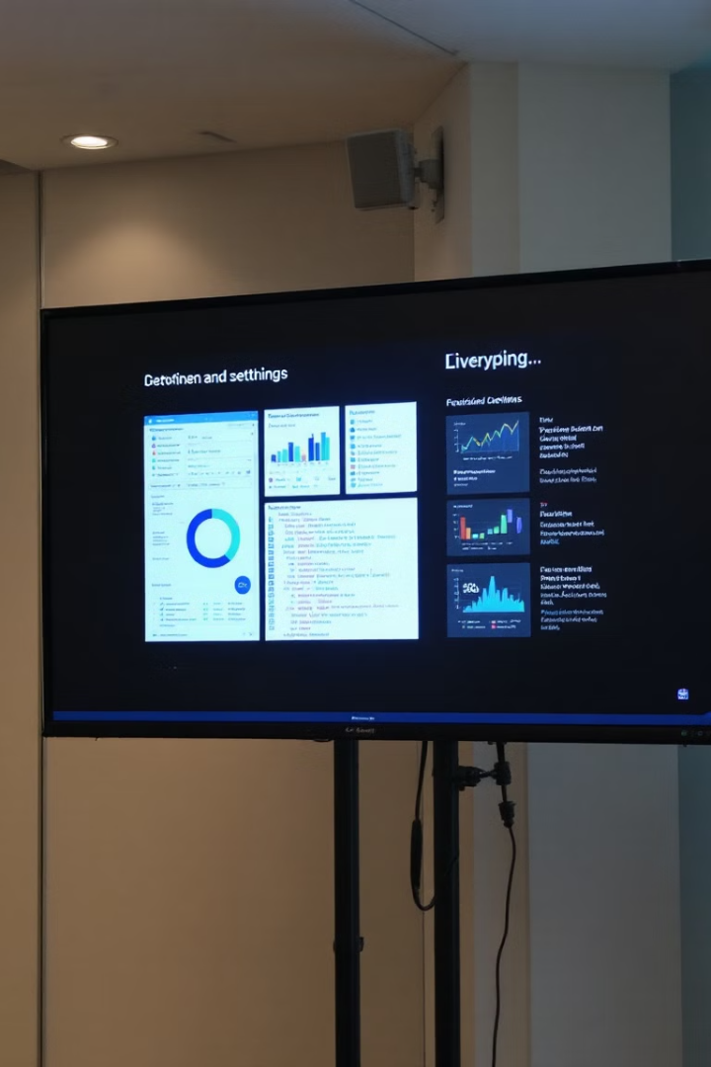
波士顿房价预测
本次演示将介绍用线性回归模型预测房价的案例。内容包括流程设计和可视化设计。
作者：刘涛

Slide 2


流程设计
1
数据预处理
2
线性回归模型
从网址中下载数据，对数据进行缺
失值处理并对非字符串数据进行
Z-score处理，对字符串数据进行
ONE-HOT编码
运用简单的线性回归模型，
并用MSE评估模型损失
4
Amad优化器
3
K折交叉验证（K=5）
运用K折交叉验证，显著降低单次划分
的随机误差，减少数据的浪费。
通过计算梯度的一阶矩（均值）和二阶矩
（方差）为不同参数设计自适应学习率

Slide 3
1
数据预处理
1.通过网址下载到初始数据
2.讲表中ID和saleprice列不参与计算的数据移除并对数值类数据进行Z-score处理，并将缺失值置为0.
3.对字符串类数据值进行ONE-HOT编码
并将所有数据转换为32位浮点数最后打
印出最终数据集的形状
代码：def download(name, cache_dir=os.path.join('..', 'data')): assert name in DATA_HUB, f"{name} 不存在于 {DATA_HUB}" url, sha1_hash = DATA_HUB[name] os.makedirs(cache_dir, exist_ok=True) fname = os.path.join(cache_dir, url.split('/')[-1]) if os.path.exists(fname): sha1 = hashlib.sha1() with open(fname, 'rb') as f: while True: data = f.read(1048576) if not data: break sha1.update(data) if sha1.hexdigest() == sha1_hash: return fname print(f'正在从{url}下载{fname}...') r = requests.get(url, stream=True, verify=True) with open(fname, 'wb') as f: f.write(r.content) return fname def download_extract(name, folder=None): fname = download(name) base_dir = os.path.dirname(fname) data_dir, ext = os.path.splitext(fname) if ext == '.zip': fp = zipfile.ZipFile(fname, 'r') elif ext in ('.tar', '.gz'): fp = tarfile.open(fname, 'r') else: assert False, '只有zip/tar文件可以被解压缩' fp.extractall(base_dir) return os.path.join(base_dir, folder) if folder else data_dir def download_all(): for name in DATA_HUB: download(name) DATA_HUB['kaggle_house_train'] = ( DATA_URL + 'kaggle_house_pred_train.csv', '585e9cc93e70b39160e7921475f9bcd7d31219ce') DATA_HUB['kaggle_house_test'] = ( DATA_URL + 'kaggle_house_pred_test.csv', 'fa19780a7b011d9b009e8bff8e99922a8ee2eb90') train_data = pd.read_csv(download('kaggle_house_train')) test_data = pd.read_csv(download('kaggle_house_test')) print(train_data.shape) print(test_data.shape)
代码：all_features = pd.concat((train_data.iloc[:, 1:-1], test_data.iloc[:, 1:])) numeric_features = all_features.dtypes[all_features.dtypes != 'object'].index all_features[numeric_features] = all_features[numeric_features].apply( lambda x: (x - x.mean()) / (x.std())) all_features[numeric_features] = all_features[numeric_features].fillna(0)
代码：all_features = pd.get_dummies(all_features, dummy_na=True) print(all_features.shape) n_train = train_data.shape[0] train_features = torch.tensor(all_features[:n_train].values.astype(float), dtype=torch.float32) test_features = torch.tensor(all_features[n_train:].values.astype(float), dtype=torch.float32) train_labels = torch.tensor( train_data.SalePrice.values.astype(float).reshape(-1, 1), dtype=torch.float32)
最终数据集形状(2919, 330)

Slide 4


模型选择：线性回归
2
1.模型和损失函数构建
代码：
def get_net(): net = nn.Sequential(nn.Linear(in_features, 1)) return net def log_rmse(net, features, labels): clipped_preds = torch.clamp(net(features), 1, float('inf')) rmse = torch.sqrt(loss(torch.log(clipped_preds), torch.log(labels))) return rmse.item()
2.模型训练函数
def train(net, train_features, train_labels, test_features, test_labels, num_epochs, learning_rate, weight_decay, batch_size): train_ls, test_ls = [], [] train_iter = d2l.load_array((train_features, train_labels), batch_size) # 这里使用的是Adam优化算法 optimizer = torch.optim.Adam(net.parameters(), lr=learning_rate, weight_decay=weight_decay) for epoch in range(num_epochs): for X, y in train_iter: optimizer.zero_grad() l = loss(net(X), y) l.backward() optimizer.step() train_ls.append(log_rmse(net, train_features, train_labels)) if test_labels is not None: test_ls.append(log_rmse(net, test_features, test_labels)) return train_ls, test_ls
3.参数定义和模型训练
k, num_epochs, lr, weight_decay, batch_size = 5, 100, 5, 0, 64 train_l, valid_l = k_fold(k, train_features, train_labels, num_epochs, lr, weight_decay, batch_size) print(f'{k}-折验证: 平均训练log rmse: {float(train_l):f}, ' f'平均验证log rmse: {float(valid_l):f}')

Slide 5



模型架构与训练策略
K折交叉验证
Adam优化器
代码：def get_k_fold_data(k, i, X, y): assert k > 1 fold_size = X.shape[0] // k X_train, y_train = None, None for j in range(k): idx = slice(j * fold_size, (j + 1) * fold_size) X_part, y_part = X[idx, :], y[idx] if j == i: X_valid, y_valid = X_part, y_part elif X_train is None: X_train, y_train = X_part, y_part else: X_train = torch.cat([X_train, X_part], 0) y_train = torch.cat([y_train, y_part], 0) return X_train, y_train, X_valid, y_valid def k_fold(k, X_train, y_train, num_epochs, learning_rate, weight_decay, batch_size): train_l_sum, valid_l_sum = 0, 0 for i in range(k): data = get_k_fold_data(k, i, X_train, y_train) net = get_net() train_ls, valid_ls = train(net, *data, num_epochs, learning_rate, weight_decay, batch_size) train_l_sum += train_ls[-1] valid_l_sum += valid_ls[-1] if i == 0: d2l.plot(list(range(1, num_epochs + 1)), [train_ls, valid_ls], xlabel='epoch', ylabel='rmse', xlim=[1, num_epochs], legend=['train', 'valid'], yscale='log') print(f'折{i + 1}，训练log rmse{float(train_ls[-1]):f}, ' f'验证log rmse{float(valid_ls[-1]):f}') return train_l_sum / k, valid_l_sum / k
代码：
train_iter = d2l.load_array((train_features, train_labels), batch_size)
optimizer = torch.optim.Adam(net.parameters(),
lr=learning_rate,
weight_decay=weight_decay)
作用：可以动态调整每个参数的学习率
作用：提高模型的泛化能力，提高数据的利用率，减少数据随机划分的影响

Slide 6
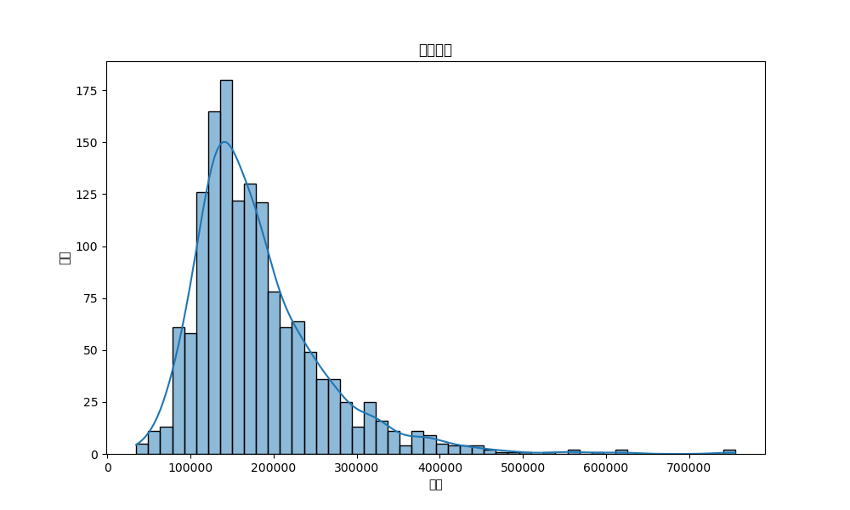
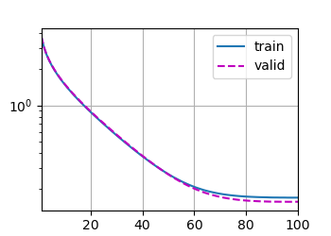
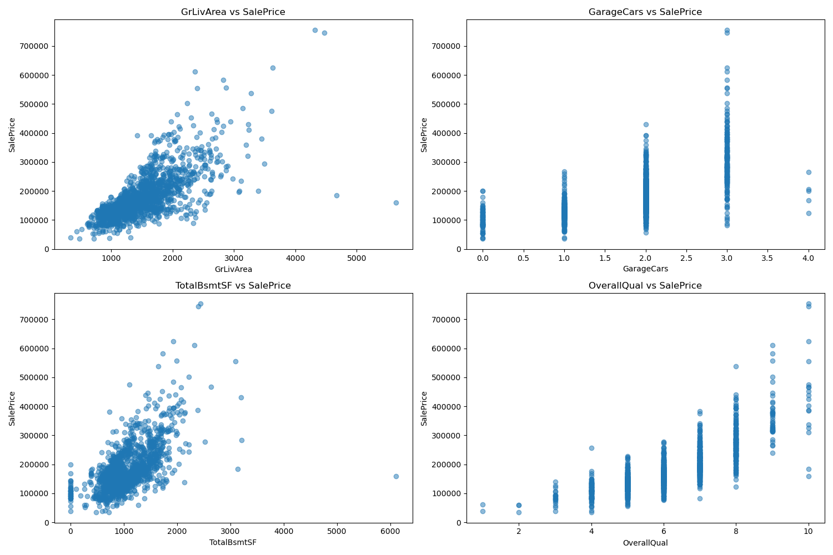
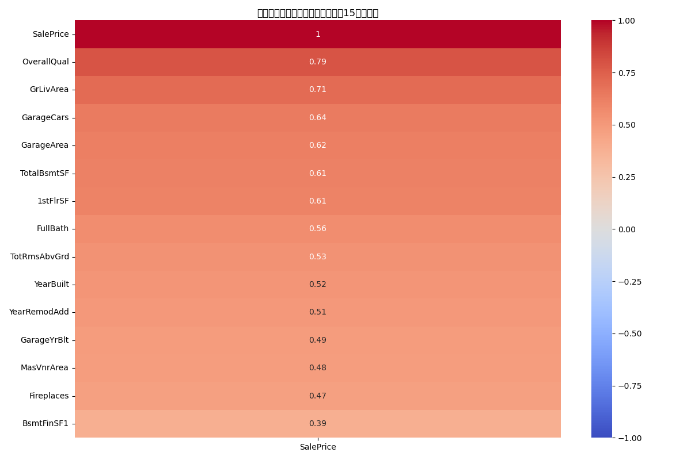
可视化结果输出：
图1：rmse随epoch变化过程训练集和验证集的差距
图2：房价频率的分布图
图3：影响房价的变量权重排名热图(前15名）
图4：房价与排名前几的变量的关系图示

Slide 7




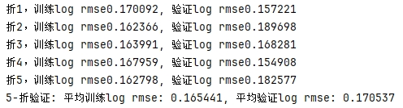
实验结果与预测输出
训练过程可视化
最终表现
结果文件生成
训练/验证误差曲线。
submission.to_csv。

Slide 8

改进方向：模型与特征层面
1
模型层面
尝试多层神经网络/树模型。
2
特征层面
特征交叉/非线性变换。
3
训练策略
学习率调度/早停法。

Slide 9

总结与建议
通过结构化设计，PPT呈现了代码技术要点与价值。每页突出核心观点，配合代码和可视化图表增强表现力。持续优化模型与特征，提升预测精度。

